Slide 1


vs
Why MacOS is better than windows?

Slide 2
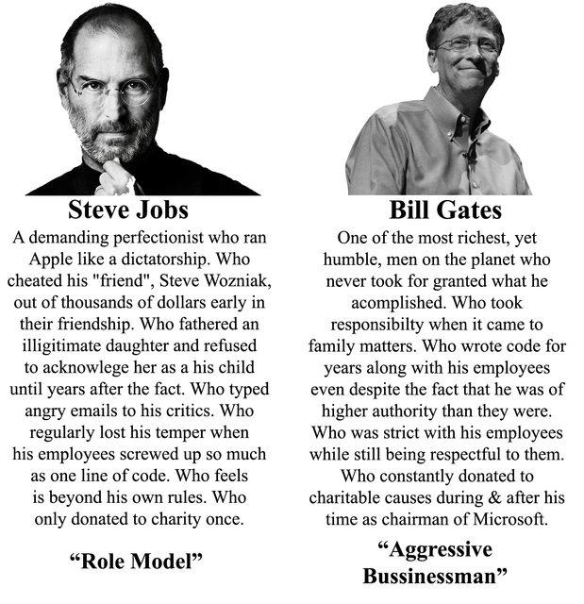
(ROLE MODEL)
(AGGRESSIVE BUSINESSMAN)
February 24, 1955 - October 5, 2011
Chief executive officer (CEO), and co-founder of Apple Inc.
October 28,1955 – TBA
Chairman,CEO and chief software architect Of Microsoft corporation.

Slide 3

Advantages/Disadvantages Of MAC & Windows- Operating System

Slide 4
 | MacOS | Windows
Operating system | Free | $120+
Write docs, books.. | Free | Buy office
Make a video or a song | Free | Well... trial software?
Spread sheets, presentations | Free | Buy office

Slide 5

Price & Quality

Slide 6
 | MacOS | Windows
Software update | Free | Windows 10 home/ pro $120 / $200
Buy office | Free | Office 365 home $79.99 (per year) / office 365 personal $59.99 (per year) / office home & student 2016 for PC $119.99(one time purchase)
Video /content create | imovie (official software) Free | Well... Trial software ?/ Have to buy
Create a song | Garage band | _

Slide 7
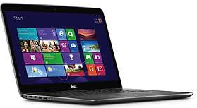
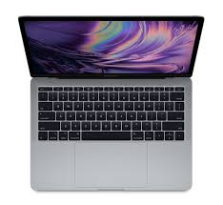
Laptops
 | Expensive windows machine | Macbook
Stability | Stable | Very Stable
Price(approx.) | =$1400? | =$1500?
Example
Age | Lasts some years | 5-7 years
Resell value | Acceptable | Very high

Slide 8
5 reasons to get an Apple Mac instead of a Windows
1.Macs are easier to buy.
2.Apple MacOs can be simpler to use, but that depends on personal preference.
3.The Apple ecosystem.
4.New versions of MacOs are always free.
5.You can run Windows on Macs if you want.

Slide 9

Accessibility

Slide 10
macOS | Windows
- | Window Snapping
Good for developers(none C#) | Good VR System
Better for Designers | Better for Al and ML
Mostly Open Source | Great User Group Polices
Unix Based (terminal)
Virtual Desktops | Virtual Desktop
Full Encryption
Proper Backups
Spotlight Search
Better Privacy
Better Security
Easily run win/linux(virtual machine) | Easily run win / linux (virtual machine)
Easily run Mac(virtual machine)
Powerful Screenshots
Screen Recorder
Revert Files to Older Versions

Slide 11
Score card
Operating System face off:
 | OS X EL Captain | Windows 10
performance | 1
search | 1
Web browsing | 1
interface |  | 1
multitasking |  | 1
Phone integration | 1
Apps and app store | 1
Sharing and social integration |  | 1
security | 1
settings | 1
Special features |  | 1
Total points: | 7 | 4

Slide 12


Personal Thoughts

Slide 13


Thank You

